Slide 1
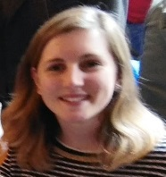

Enabling Federated Login to WLCG
Authentication and Authorisation for Research and Collaboration
Hannah Short (CERN)
Presented by David Groep
AARC - Policy and Best Practice Coordination
DI4R
28 September 2016

Slide 2
Agenda
What is Federated Access?
Why should WLCG adopt it?
What does WLCG need from Federated Access?
Example Services
How can I implement this?

Slide 3
Agenda
What is Federated Access?
Why should WLCG adopt it?
What does WLCG need from Federated Access?
Example Services
How can I implement this?

Slide 4
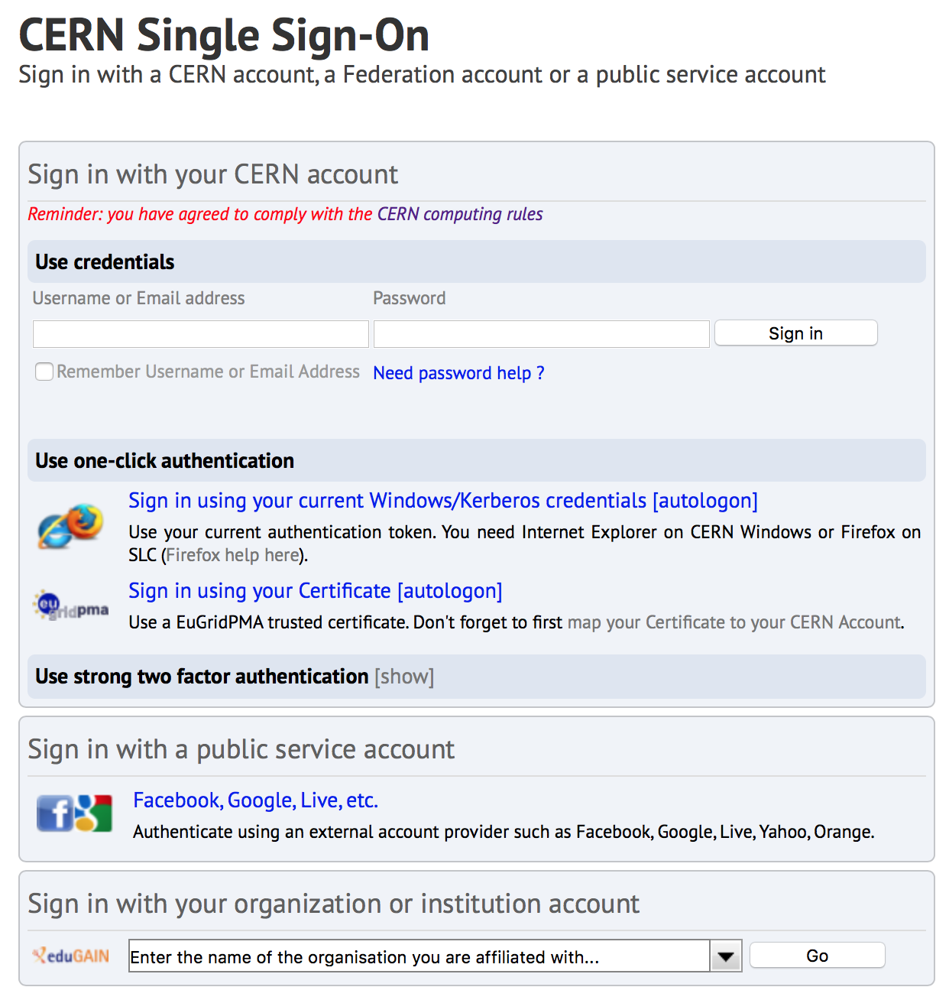
What is Federated Access?
The ability to log in to a service using an identity managed by a separate organisation
eduGAIN ‘is’ the international group of services and identity providers using Federated Login
Has become common practice within Research and Education for access to web-based services

Slide 5
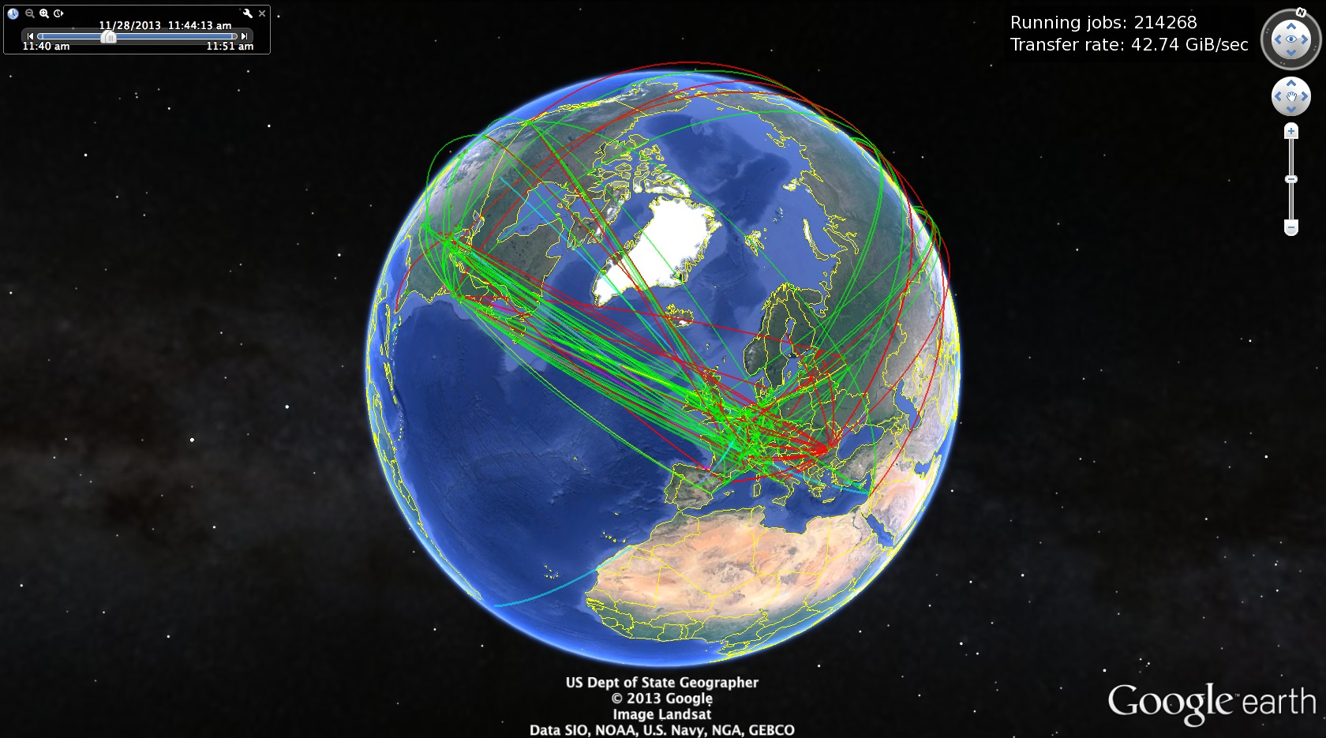
Authentication and Authorisation at WLCG
“To use WLCG you must possess a personal digital certificate from a Certification Authority (CA) recognised by WLCG” [1]
End users own and manage these certificates
Certificate renewal
Grid Proxy Certificate generation
Users then enroll in ‘VOMS’ using this certificate
VOMS defines roles and groups for additional authorisation expressed as attribute certificates embedded in ‘RFC3820’ proxy certificates
Maybe it’s time for a different approach?
[1] http://wlcg.web.cern.ch/getting-started/certificates

Slide 6
Agenda
What is Federated Access?
Why should WLCG adopt it?
What does WLCG need from Federated Access?
Example Services
How can I implement this?

Slide 7
Why should WLCG adopt Federated Access?
Mobility
Usability
Security
Certificate management not in skillset of early career researchers
Users expecting “GAFA” experience, Single-Sign-On across tools
Certificates are powerful when in the wrong hands
Private keys leaked by users
One learning curve we can remove
Certificates left on shared devices
Coupling credentials with devices is not necessarily valid for highly mobile researchers
Burden on users for each new device

Slide 8
Agenda
What is Federated Access?
Why should WLCG adopt it?
What does WLCG need from Federated Access?
Example Services
How can I implement this?

Slide 9
What does WLCG need from Federated Access?
1
2
3
Trustworthy eduGAIN users
Web and Command Line access
VOMS Authorisation

Slide 10

1. Trusting eduGAIN Users
User
User
x.509
How can eduGAIN assertions be as trustworthy as x.509 certificates?
Restrict eduGAIN to trusted partners
Sirtfi
Research & Scholarship
Restrict access to known users
EduGAIN token transformed into x.509 ONLY if the user is registered in VOMS (we’ll come back to this later…)

Slide 11
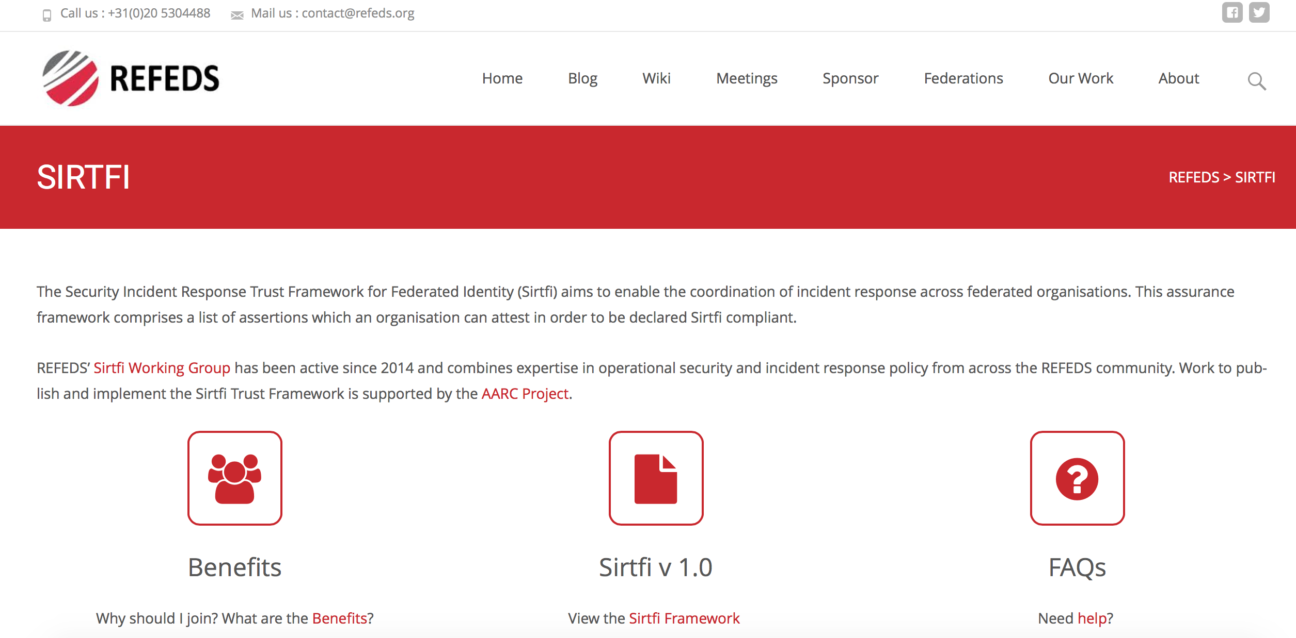
1. Sirtfi
A flag for organisations that
Have a good baseline in operational security
Provide a security contact point for emergencies
Are able and willing to participate in incident response
These are organisations we want to work with!
https://refeds.org/sirtfi
https://refeds.org/sirtfi

Slide 12

2. Research & Scholarship
A flag for organisations that
Serve the Research & Education community
Agree to release the attributes
Name
Email
Unique Identifier
CERN SSO requires this set of attributes, users from these organisations should be able to log in without a problem
Sirtfi
R&S
OK!
https://refeds.org/category/research-and-scholarship

Slide 13
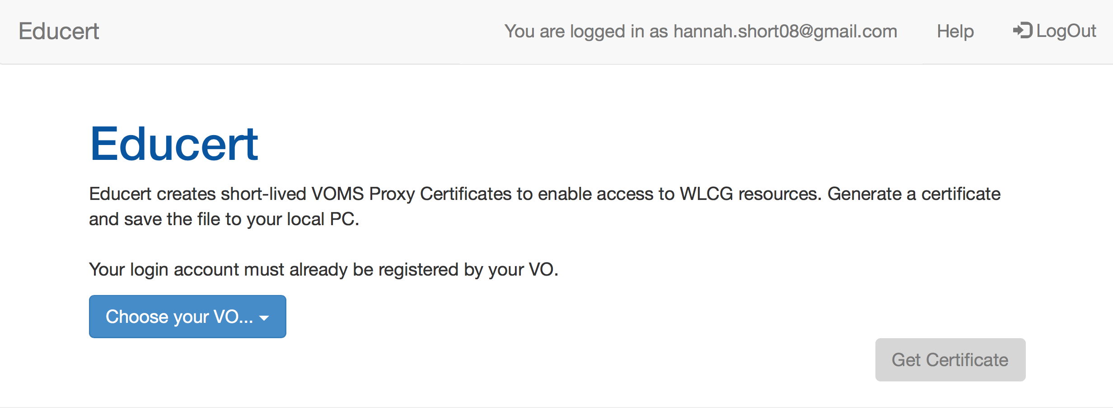
2. Web and Command Line Access
The primary use case for SAML (the protocol used for Federated Login) is Web-Based Authentication whereas our users spend their life on the command line
Several Command Line solutions exist (ECP, CiLogon, Moonshot) but
Require configuration at home organisations (takes time and resources), or,
Are not yet available for Europe
At CERN, a prototype service, Educert, is available for generating GridProxy certificates for download

Slide 14
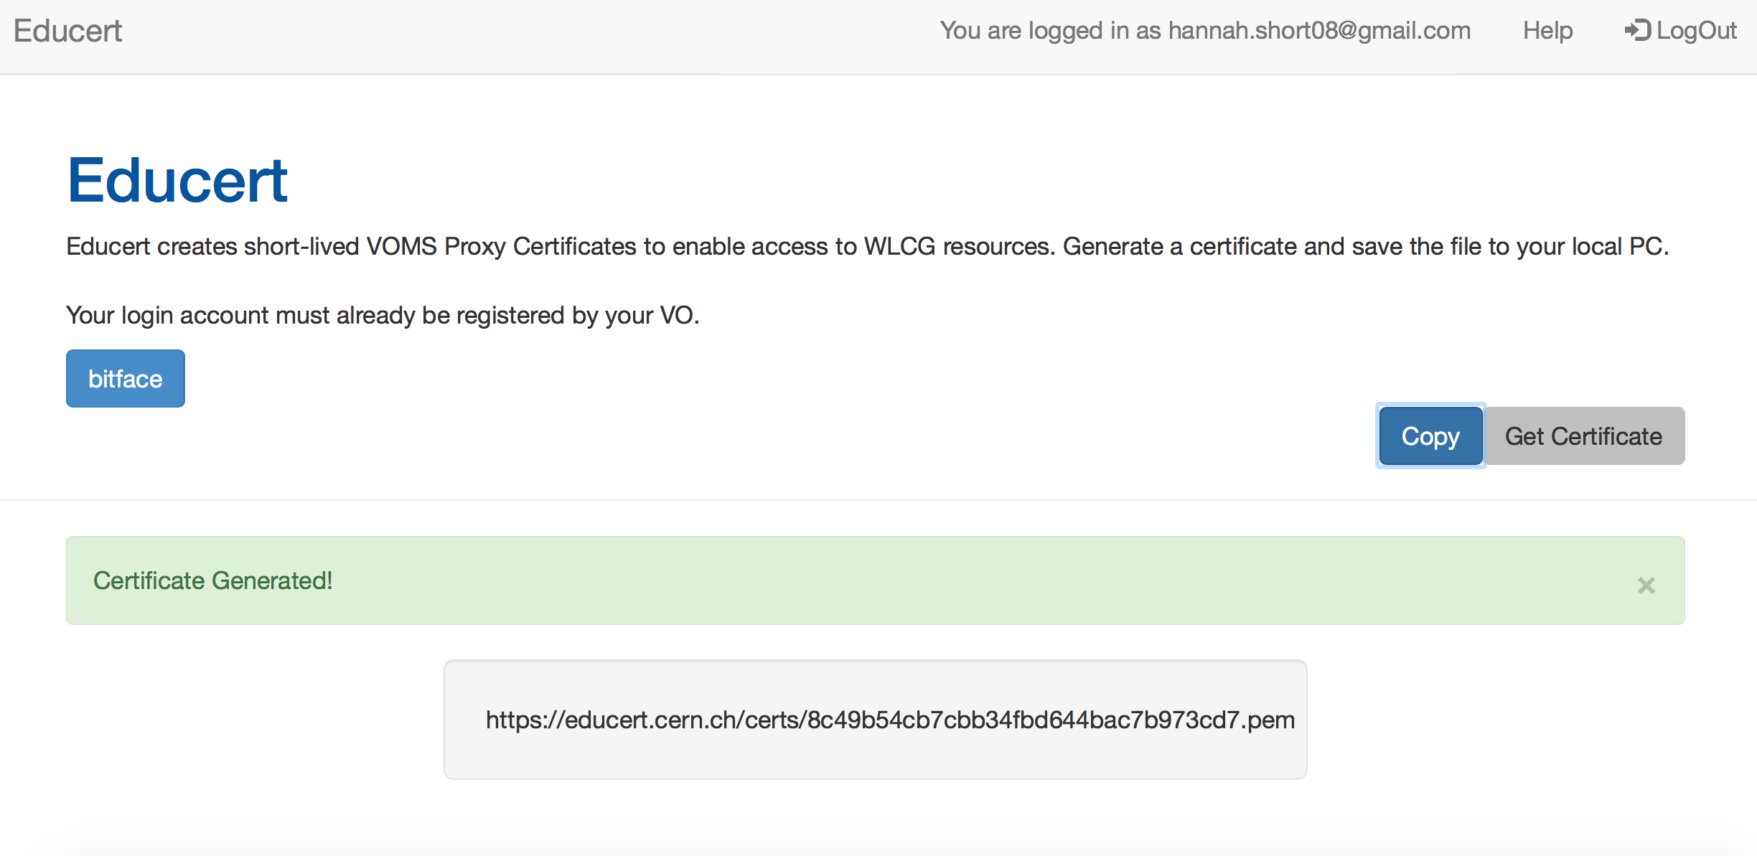
2. Web and Command Line Access

Slide 15
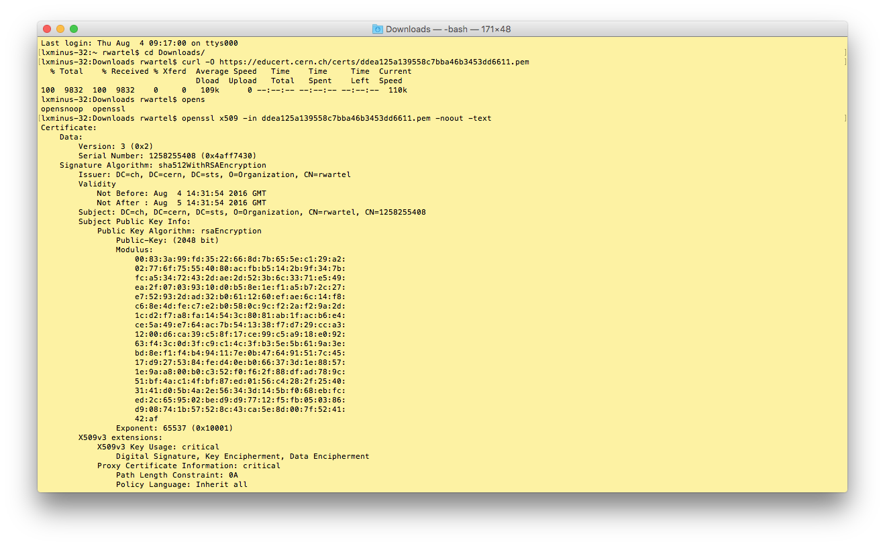
2. Web and Command Line Access

Slide 16
3. VOMS Integration
Hang on - I need to have a certificate to register in VOMS in the first place!
How is this going to work?

Slide 17
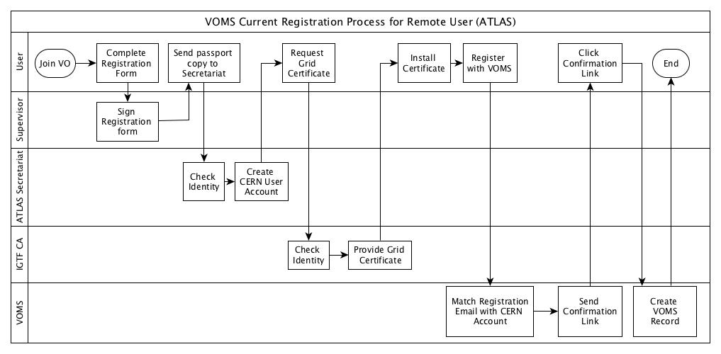
3. VOMS Registration – in the WLCG and CERN HR context
Notes:
Important
Supervisor involved
Identity checked by CERN and CA
VOMS registration requires CERN User Account & IGTF Accredited Certificate

Slide 18
3. VOMS Registration
Notes:
Important
Supervisor involved
Identity checked by CERN and CA
VOMS registration requires CERN User Account & IGTF Accredited Certificate

Slide 19
Agenda
What is Federated Access?
Why should WLCG adopt it?
What does WLCG need from Federated Access?
Example Services
How can I implement this?

Slide 20
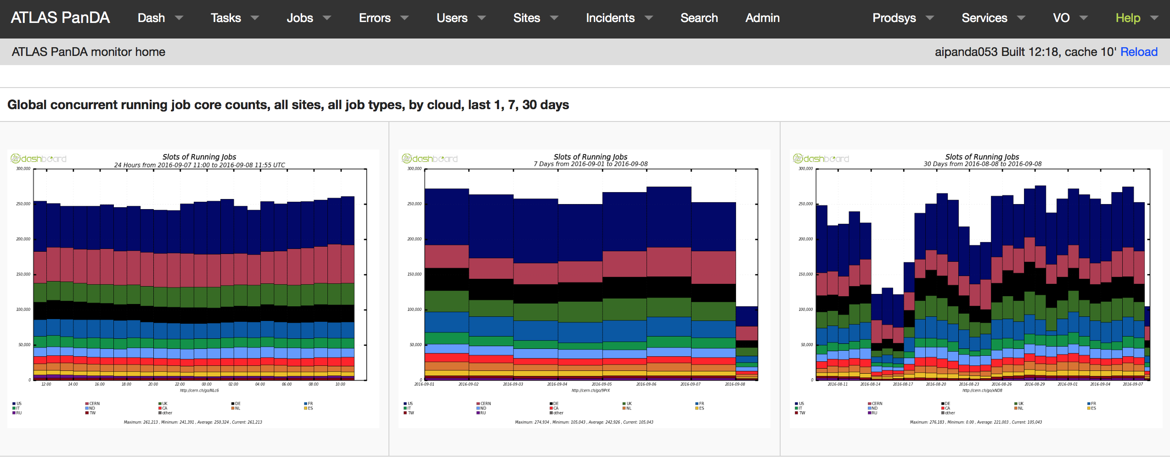
Example Services – ATLAS PanDA (Bigpanda)
What is it?
Jobs monitoring service for ATLAS
Contacts additional services that require certificates
Why enable federated access?
Security – logs are open to wide audience and should be controlled by user certificates
Finer granularity of user control possible with SSO – e-groups, user groups etc
In progress

Slide 21
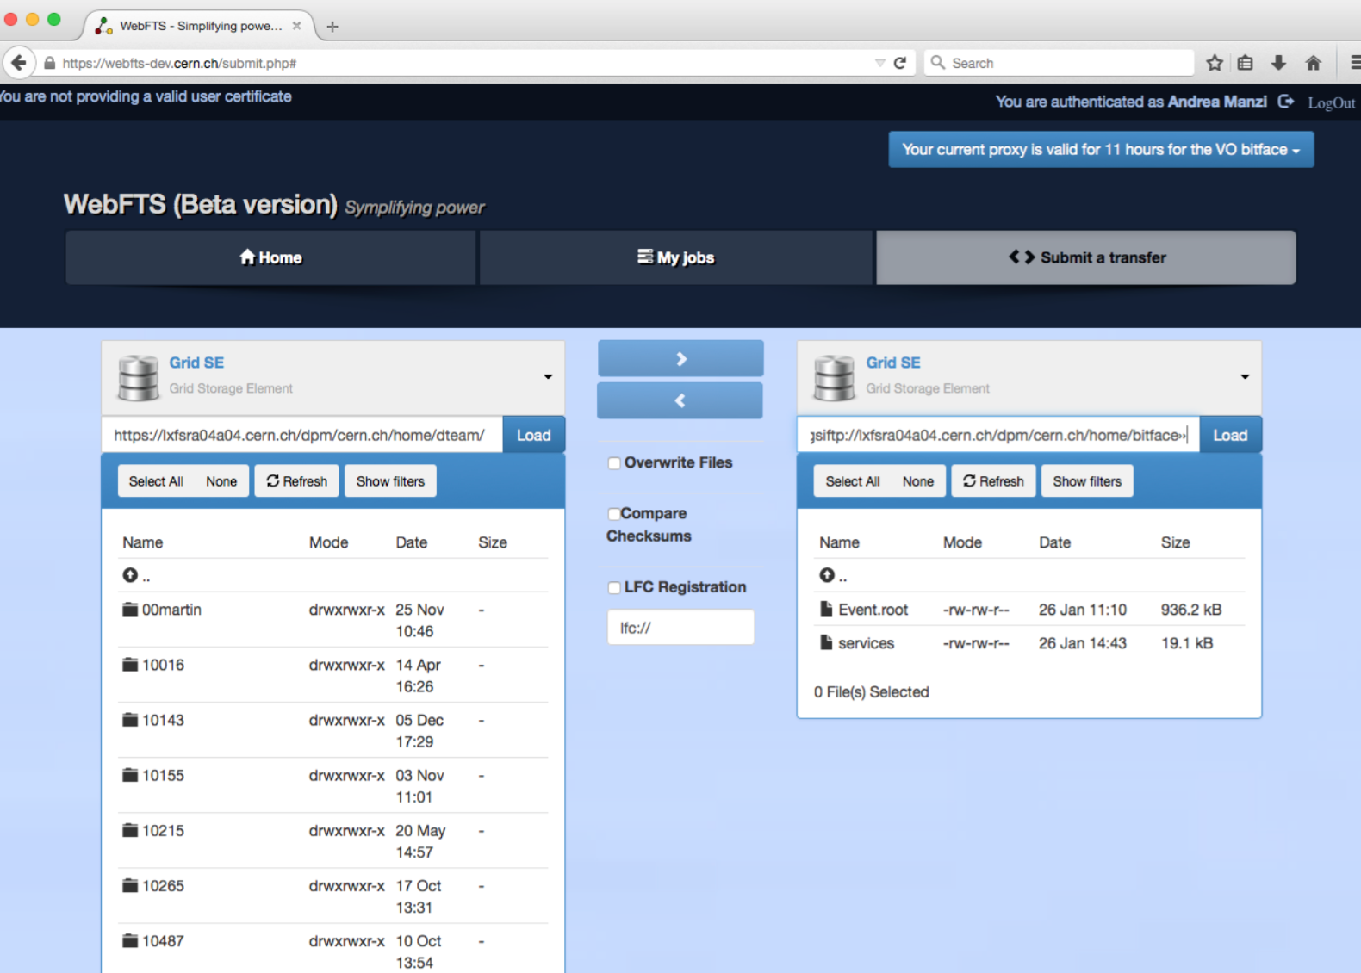
Example Service – WebFTS (pilot)
What is it?
https://webfts.cern.ch
Web based tool to transfer files between grid/cloud storages
Modular protocol support
gsiftp, http(s), xrootd and srm
Cloud extensions: dropbox, CERNBox
Initial development funded by EUDAT
Why enable Federated Access?
X509 delegation is needed to let WebFTS access the grid on users behalf
We are trying to replace user certificate delegation with transparent access via Identity Federation
Pilot
Credit to Andrea Manzi (CERN) and Andrey Kiryanov (CERN)
https://indico.cern.ch/event/358127/contributions/848191/subcontributions/65475/attachments/713135/979052/WebFTS_FIM_pilot.pdf

Slide 22
Agenda
What is Federated Access?
Why should WLCG adopt it?
What does WLCG need from Federated Access?
Example Services
How can I implement this?

Slide 23


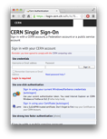
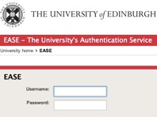


How can I implement this? – the CERN WLCG prototype
IOTA
CA
STS
IdP
IdP
IdP
CERN SSO
IdP
VOMS
SAML
X.509
VOMS
SAML
Credentials
Attributes
Redirect
Web service
WLCG
Grid
X.509
VOMS
Web
also please see https://aarc-project.eu/aarc-draft-blueprint-architecture-available-for-comments/

Slide 24
Components
CERN SSO
IOTA CA
STS
A "Single Sign On" (SSO) endpoint is required to configure your service as a CERN Service Provider. Shibboleth or Mellon are the recommended technologies to use and are supported by CERN IT. ​A user's SAML Assertion can be exported from the local SSO Service and sent to STS for transformation to an x.509 certificate.
The "Security Token Service" (STS) takes SAML tokens, or username and password pairs, and transforms them into x.509 certificates​. STS uses the IOTA CA to generate short-lived certificates for users registered with their WLCG Virtual Organisation (VO) in VOMS.
The "Identifier Only Trust Assurance" (IOTA) Certificate Authority (CA) issues short-lived x.509 certificates to STS clients. IOTA Certificates will only be issued to users from Virtual Organisations (VOs) that employ strong identity vetting, such as WLCG VOs.

Slide 25
Pre-requisites
Stand-alone web service
Apache web service
Not centrally hosted!
Appropriate Users
Users must belong to a VO with strong identity vetting, i.e. WLCG
The IOTA CA will only issue certificates to these users!
Must be able to install SAML2.0 SP locally – not on a load balancer as tokens issued must be specific to the host

Slide 26
How can I implement this?
Enable SSO
Create an STS instance
Authorise users with VOMS
The following slides are a summary. Full documentation is available at:
https://espace.cern.ch/authentication/CERN%20Authentication/WLCG%20Federated%20Access.aspx

Slide 27

Enable SSO
Your Web Service must be enabled as a SAML2 Service Provider
Supported technologies at CERN are:
Mellon https://espace.cern.ch/authentication/CERN%20Authentication/Configure%20a%20Mod_MellonA%20Application.aspx
Shibboleth https://espace.cern.ch/authentication/CERN%20Authentication/Configure%20a%20Shibboleth%20Application.aspx
Register your service with CERN SSO
You will be connected to eduGAIN via the CERN SSO IdP/SP Proxy
SAML2
SP
CERN
SSO

Slide 28
Create an STS instance
To make installation simple…
STS is available as a puppet module at https://gitlab.cern.ch/ai/it-puppet-module-sts
STS Virtual Machines should be created in the Puppet hostgroup federatedidentity/sts, which includes all additional modules and packages required for easy installation
Configure your STS service with Puppet (example below)
sts::config::entity_id: https://educert.cern.ch/
sts::config::consumer_service_url: https://educert.cern.ch/Shibboleth.sso/SAML2/POST
sts::config::voms_base_url: https://ftsvoms01.cern.ch:8443/voms/bitface
sts::config::vo_name: /bitface
sts::config::vomses_file: /etc/vomses/bitface-ftsvoms01.cern.ch
sts::config::match_attribute_name: eduGAINID
sts::config::incoming_attribute_id: http://schemas.xmlsoap.org/claims/CommonName
We’ll move on to this in a second!

Slide 29

Authorise users with VOMS
User data is contained in the incoming SAML assertion – at CERN we use CommonName to identify users
IdP
<AttributeStatement>
<Attribute Name=“UPN">
<AttributeValue>hannah.short08@gmail.com</AttributeValue>
</Attribute>
<Attribute Name=“EmailAddress">
<AttributeValue>hannah.short08@gmail.com</AttributeValue>
</Attribute>
<Attribute Name=“CommonName">
<AttributeValue>f72ba133e9413837dea1</AttributeValue>
</Attribute>
</AttributeStatement>
CERN SSO
Web Service

Slide 30
Authorise users with VOMS
VOMS attributes can be configured for each user. Here we have set up an eduGAINID attribute for the user that matches the incoming CommonName.
<Record>
<Personal information />
<Certificates />
<Groups and Roles />
<Attributes >
<Attribute Name=“eduGAINID">
<AttributeValue>f72ba133e9413837dea1</AttributeValue>
</Attribute>
</Attributes>
</Record>
IdP
CERN SSO
Web Service
STS
VOMS

Slide 31
Authorise users with VOMS
Depending on your VO, you may be able to use VOMS Authorisation already!
For some VOs, nickname contains the CERN ID, e.g. jsmith, of the user
Currently all users have CERN IDs, since they all have CERN accounts
We are working on how to make this work smoothly for future users without a CERN account ☺
<AttributeStatement>
<Attribute Name=“EmailAddress">
<AttributeValue>hannah.short08@gmail.com</AttributeValue>
</Attribute>
<Attribute Name=“CommonName">
<AttributeValue>jsmith</AttributeValue>
</Attribute>
</AttributeStatement>
<Record>
<Personal information />
<Certificates />
<Groups and Roles />
<Attributes >
<Attribute Name=“nickname">
<AttributeValue>jsmith</AttributeValue>
</Attribute>
</Attributes>
</Record>
SAML Assertion
VOMS Record

Slide 32
Agenda
What is Federated Access?
Why should WLCG adopt it?
What does WLCG need from Federated Access?
Example Services
How can I implement this?

Slide 33
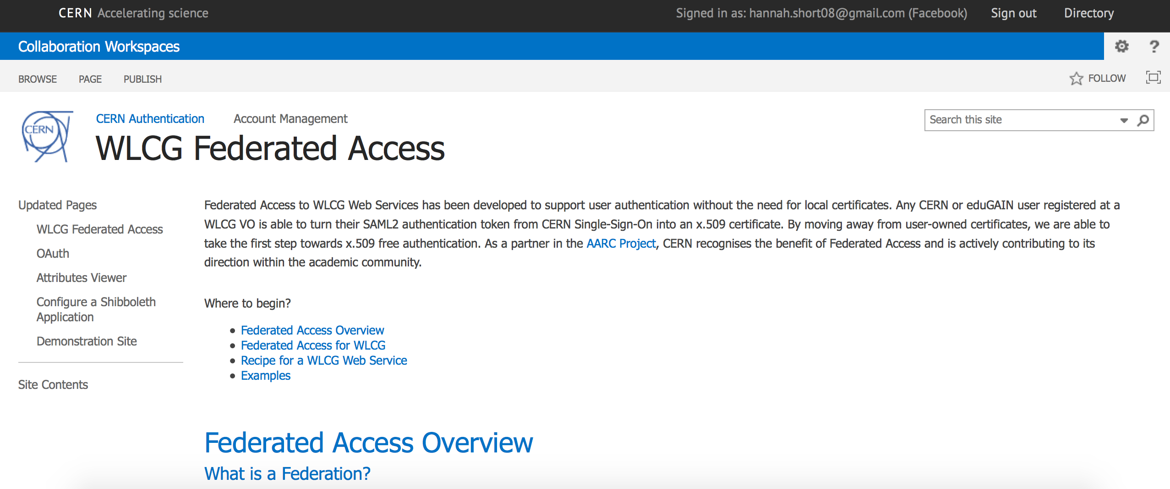
Conclusions
eduGAIN provides a pool of users from which we can select those we trust via Sirtfi
Command line solutions are around the corner and a prototype service, Educert, is a viable lightweight option
VOMS registration without user certificates is the next milestone but deployment can begin in parallel
Visit https://espace.cern.ch/authentication/CERN%20Authentication/WLCG%20Federated%20Access.aspx

Slide 34
hannah.short@cern.ch
davidg@nikhef.nl

